Slide 1
Disclaimer: the information provided herein is not legal advice and should not be relied upon as such.

Slide 2
EMPLOYMENT LAW UPDATE
Stacey Trien strien@adamsleclair.law (585) 327-4110

Slide 3
Trends in Discrimination Claims
Notes:
Filing of discrimination claims with the Division of Human Rights and in court have increased exponentially over the past year

Slide 4
Workplace Sexual Harassment Complaints Filed With DHR
Notes:
Division of Human Rights – NYS administrative agency that processes discrim claims
Instead of filing a lawsuit in court
DHR attributes to new law requiring sex harassment training
I believe it also has to do with pandemic-era changes to the process

Slide 5
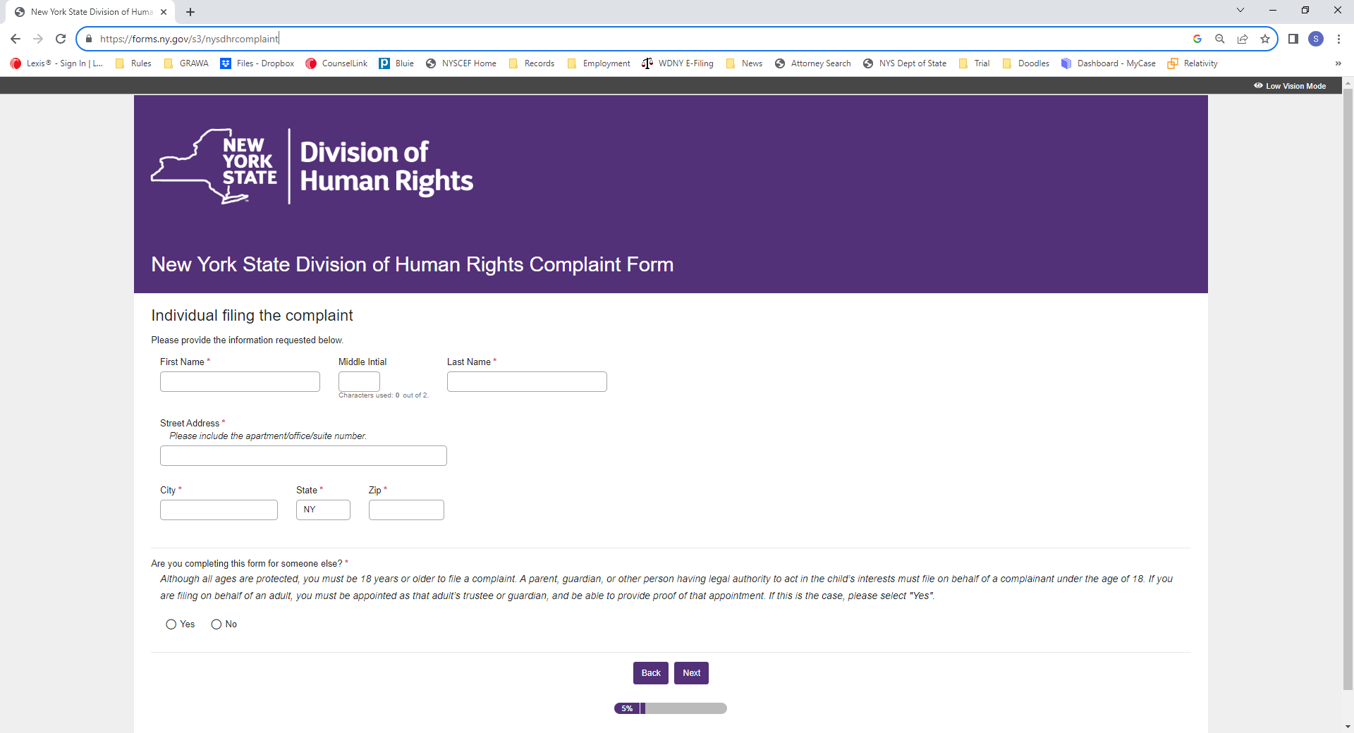

Slide 6
Discrimination Claims
Sexual Harassment
Disability
Retaliation
Notes:
Harassment – new standard as of Oct. 11, 2019 –
subject an individual to inferior terms, conditions or privileges of employment
More than petty slights/trivial inconveniences

Slide 7
Marijuana Discrimination Labor Law 201-d
Political activities
Recreational activities
Membership in a union
Refusal to attend employer-sponsored meeting or speech regarding religious or political matters
Legal use of “consumable products including cannabis”

Slide 8
Marijuana in the Workplace
Labor Law 201-d
Employers are prohibited from discriminating against employees based on employee’s LEGAL use of marijuana:
Outside the Workplace
Outside of Work Hours
Without use of employer’s equipment or property
Notes:
This means if they are at the workplace, during work hours, or using company equipment, you can impose discipline

Slide 9
What is legal use?
Legal Use = 21 years or older
Illegal Use:
Driving while using/under the influence
Where smoking tobacco is prohibited
Sell without a license
Federal land

Slide 10
What are Work Hours?
Meal Periods
Paid and unpaid breaks
Engaged in work
Notes:
Not the same as work hours for purposes of calculating compensation
Even if the employee leaves the worksite, still work hours
Includes on call time

Slide 11
What is Employer’s Premises?
Company property
Worksite
Company vehicles
Any areas used by employees (rest breaks, etc.)
NOT: remote workplace/working at home
Notes:
Prohibit possession at the workplace:
Workplace includes
Remote: unless employee is exhibiting symptoms of being under the influence at work

Slide 12
What to Do if Employee is Using During Work Hours or on Employer’s Premises?
“Employee manifests specific articulable symptoms of impairment” that:
Decrease performance of their duties
Interfere with your obligation to provide a safe workplace
Notes:
Can send them home, terminate employment, or take any other action you deem appropriate
Document the symptoms, witnesses, any information you have to support your belief employee was using during work hours or on premises

Slide 13
Drug Testing
Pre-Employment Testing
Not unless state or federal law requires
E.g. driving commercial vehicle (federal law requires)
Testing on the Job
Cannot use testing to determine if someone is impaired
Can test if state/federal law requires drug testing
Notes:
Cannot have a general policy drug testing every employee as a condition for employment
E.g. if you have office staff, cannot require drug tests as condition of employment prior to hiring, or conduct random drug tests where they do not meet the conditions of being under the influence at work
Exception: if state or federal law requires pre-employment testing
Testing on the job
Not to determine if impaired
Yes if state/federal law requires it

Slide 14
Exceptions:
Employees working outside New York State
Federal or state law requires drug testing or drug free position:
E.g. drivers of commercial motor vehicles (federal & state law)
Collective Bargaining Agreement
Notes:
Rich will speak more about when federal/state law requires drug testing/drug free zones

Slide 15
Medical Marijuana
Disability
Can you accommodate without undue hardship to your business?
Notes:
Certified medical marijuana patients = certified as disabled in NY
Treated like any other disability
Interactive process

Slide 16
Marijuana Updates
Drug policy in CBA will be enforced, even if it prohibits use of medically prescribed marijuana
Employee required to test negative for marijuana prior to returning to work per CBA, 7/28/23 appellate court decision
Notes:
Because statute is still pretty new, still waiting for cases with more specific examples to move through the courts
Main concern has to be safety.
If you think an employee is creating a dangerous/hazardous condition, send him home for the day.
Document your file as to who, what, where, when with specific information.

Slide 17
Federal Labor Law
Lion Elastomasters LLC – NLRB Decision May 1, 2023
Increased protections for all speech during “concerted activity” is protected
Certain situations protection applies to vulgar, racist, inappropriate speech
Concerted activity = activity raising concerns about working conditions
Different weight if speech made to management, social media posts, co-workers, or on the picket line

Slide 18
New Laws in NY State
Wage disclosure law (9/17/23)
New model sexual harassment policy (Apr. 2023)
Whistleblower protections increased (2022)
Nursing mother accommodations (6/7/23)
Social media privacy – cannot ask employees for access to information in any ‘personal account’ (effective 3/12/24)
Notice eligibility unemployment benefits expanded (11/13/23)
Prohibition on mandatory meetings re: employer’s political or religious views (Sept. 2023)
Notes:
Wage disclosure: any job posting – internal or external, for jobs that will be physically performed in NYS, and workers outside NYS who report to supervisor in NYS, list min and max pay ranges
Sex harassment policy
Whistleblower protections: law now protects ees and ind Ks from raising concerns about any activity, policy or practice, proof of actual violation of law no longer necessary
Nursing mother accommodations: must designate room or location to express breast milk, not a restroom
Social media privacy
f. Notice of unemployment benefits – any reduction in hours resulting in total or partial unemployment – whether they resign or are terminated
g. …

Slide 19
Links:
New model sexual harassment policy (Apr. 2023):
https://www.ny.gov/combating-sexual-harassment-workplace/sexual-harassment-prevention-model-policy-and-training
Unemployment form:
https://dol.ny.gov/system/files/documents/2021/02/ia12_3.pdf

